Slide 1
CIS 4517/5517: Data Intensive and Cloud Computing Data mining: PageRank
Dr. Xubin He
Computer and Information Sciences
Temple University

Slide 2
Outlines
Big Data Challenges
Web Page Quality Ranking: PageRank algorithm

Slide 3
Quick review from the last class: Map-Reduce
Programmer specifies:
Map and Reduce and input files
Workflow:
Read inputs as a set of key-value-pairs
Map transforms input kv-pairs into a new set of k'v'-pairs
Sorts & Shuffles the k'v'-pairs to output nodes
All k’v’-pairs with a given k’ are sent to the same reduce
Reduce processes all k'v'-pairs grouped by key into new k''v''-pairs
Write the resulting pairs to files
All phases are distributed with many tasks doing the work
Input 0
Input 1
Input 2
Map 0
Map 1
Map 2
Shuffle
Reduce 0
Reduce 1
Out 0
Out 1

Slide 4
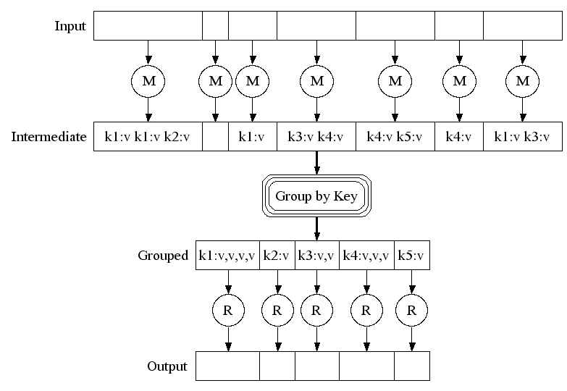
Map-Reduce: A diagram
Big document
MAP:
Read input and produces a set of key-value pairs
Group by key:
Collect all pairs with same key
(Hash merge, Shuffle, Sort, Partition)
Reduce:
Collect all values belonging to the key and output

Slide 5
Applications of Map-Reduce
Counting tasks
Find the total size in bytes of a host
Compute the frequency of all k-grams on the web
Compute the frequency of queries
Compute the frequency of query, url pairs
Other examples:
Link analysis and graph processing – PageRank
Machine Learning algorithms
Linear algebra operations (matrix-vector, matrix-matrix multiplication)

Slide 6
Challenges of Big Data Collection
Challenging to acquire a lot of data quickly
Need of large processing, networking, and storage throughput
Parallelism can help
Challenging to acquire useful information from a sea of irrelevant data
What data is more important than others
Identify redundancy efficiently
Collect topic‐specific data
Challenging to collect from distributed, remote data sources

Slide 7
Web Crawling
Collect published web content – crawling
First retrieve some root/seed pages;
Parse their content and follow hyperlinks to retrieve more pages;
Repeat the last step.
How is it useful?
Web search engines
Dive deep (go beyond what is provided by search engines) on a specific topic
Businesses/advertisers to find potential customers
… …

Slide 8
Goals
Collect good (high‐quality) pages
Collect web pages on a certain topic
Crawl contents efficiently
Crawl without annoying others

Slide 9
Outlines
Big Data Challenges
Web Page Quality Ranking: PageRank algorithm

Slide 10
Web Page Quality Ranking
Given so many web pages, how to quantitatively measure their quality/importance and rank them?

Slide 11
Motivation
Why important to rate web pages?
New challenges for information retrieval on the World Wide Web.
There are about 1.13 billion websites on the internet in 2023
A new website is built every three seconds
Diversity of web pages: different topics, different quality, etc.
While there are 1.13 billion websites in the world, only a fraction of these are actively used and updated. A staggering 82% are inactive, meaning only 200,121,724 of the 1.13 billion websites are actively maintained and visited.
Search engines to return high quality results.
Source: https://www.forbes.com/advisor/business/software/website-statistics/

Slide 12
Straightforward (naïve solution): Simple citation counting
If a webpage is linked (pointed to) by many other pages, this web page is “important.”
Generally, highly linked pages are more “important" than pages with fewer links.

Slide 13
Simple citation counting
How about a web page might have very a few links, even one, but this link itself is very important?
Page A is cited by only one page B, but page B is very “important” or highly linked, page B→Page A should be considered “important”
Vs. Page A’ is cited by 100 non-important pages…

Slide 14
PageRank
A method for rating the importance of web pages objectively and mechanically using the link structure of the web.
Page, Lawrence and Brin, Sergey and Motwani, Rajeev and Winograd, Terry, The PageRank Citation Ranking: Bringing Order to the Web, http://ilpubs.stanford.edu:8090/422/

Slide 15
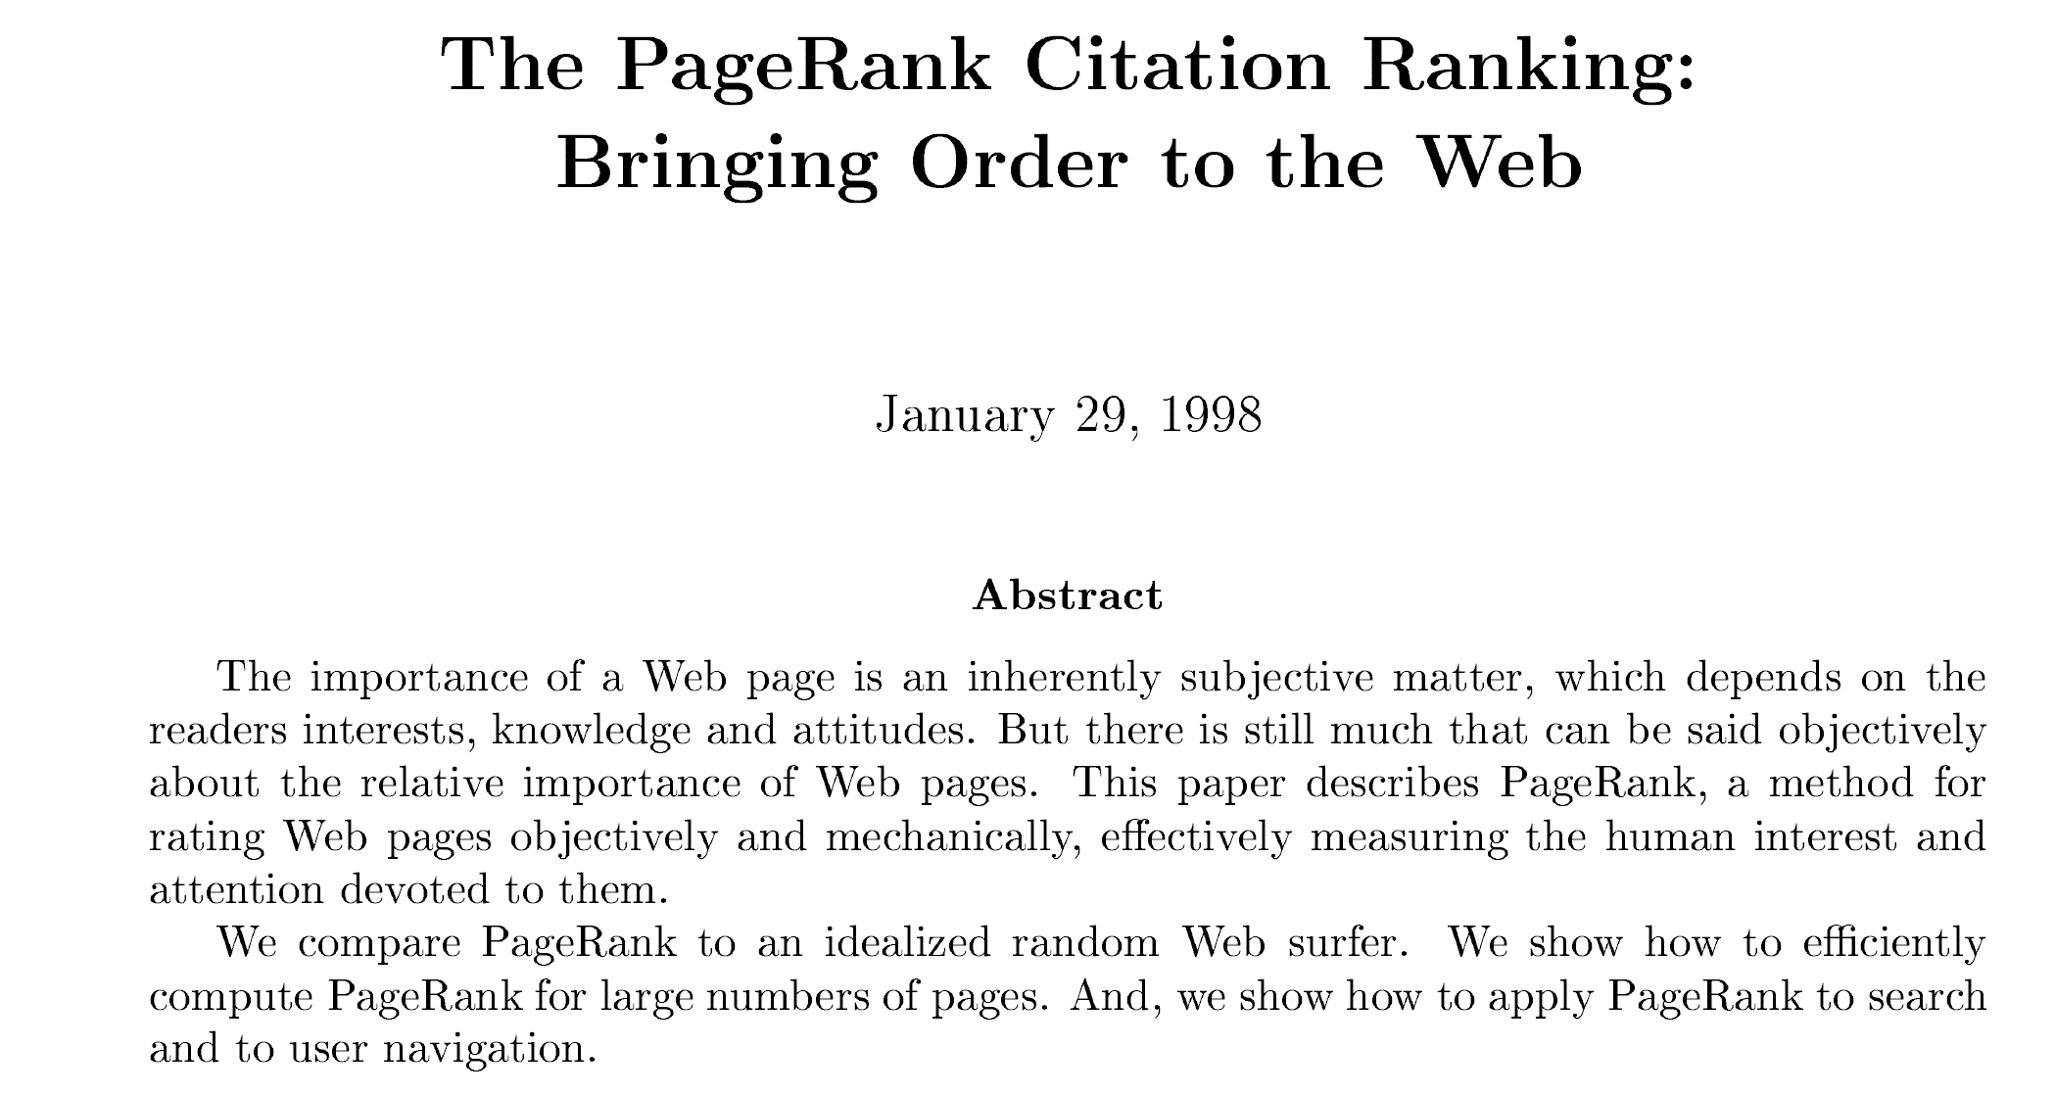

Slide 16
The History of PageRank
PageRank was developed by Larry Page and Sergey Brin.
It is first as part of a research project about a new kind of search engine at Stanford. That project started in 1995 and led to a functional prototype in 1998.
Shortly after, Page and Brin founded Google.

Slide 17
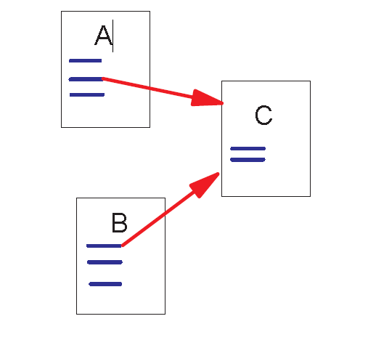
Link Structure of the Web
150 million web pages → 1.7 billion links
Backlinks and Forward links:
A and B are C’s backlinks
C is A and B’s forward link
Intuitively, a webpage is important if it has a lot of backlinks.
What if a webpage has only one link off www.yahoo.com?

Slide 18
PageRank
Simply counting the backlinks of a web page is not good enough to rank the quality of a page, we should consider both cases when a page has many backlinks and when a page has a few highly ranked backlinks.
PageRank:
A page has high rank if the sum of the ranks of its backlinks is high.
Social media: person A has 1000 followers vs person B just has one follower who is Elon Musk for Taylor Swift.

Slide 19
Web page graph
Web pages are organized in a network.
Each webpage is represented as a node.
Each hyperlink is a directed edge
The entire web can be viewed as a directed graph.

Slide 20
Importance Computation
The importance of a page is distributed to pages that it points to.
The importance of a page is the aggregation of the importance shares of the pages that points to it.
If a page has 5 outlinks (or forward links), the importance of the page is divided into 5 and each outlink receives one fifth share of the importance.

Slide 21
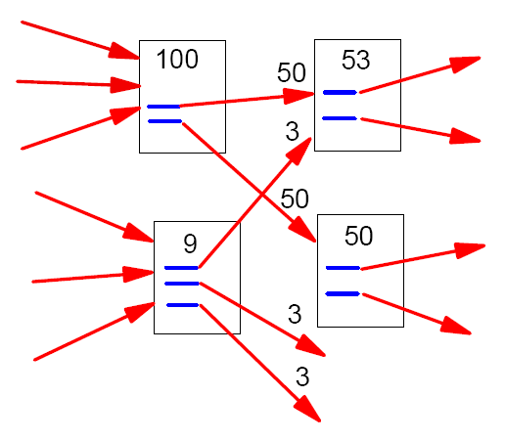
Example:
A
C
?
?
?
B
?
D
?
?
?

Slide 22
Example:
A
C
B
D

Slide 23
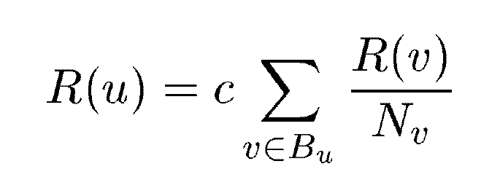
A Simple Version of PageRank
u: a web page
B_{u}: the set of u’s backlinks
N_{v}: the number of forward links of page v
c: the normalization factor so that the total rank of all web pages is constant.

Slide 24



An example (c=1)
A
B
C

Slide 25
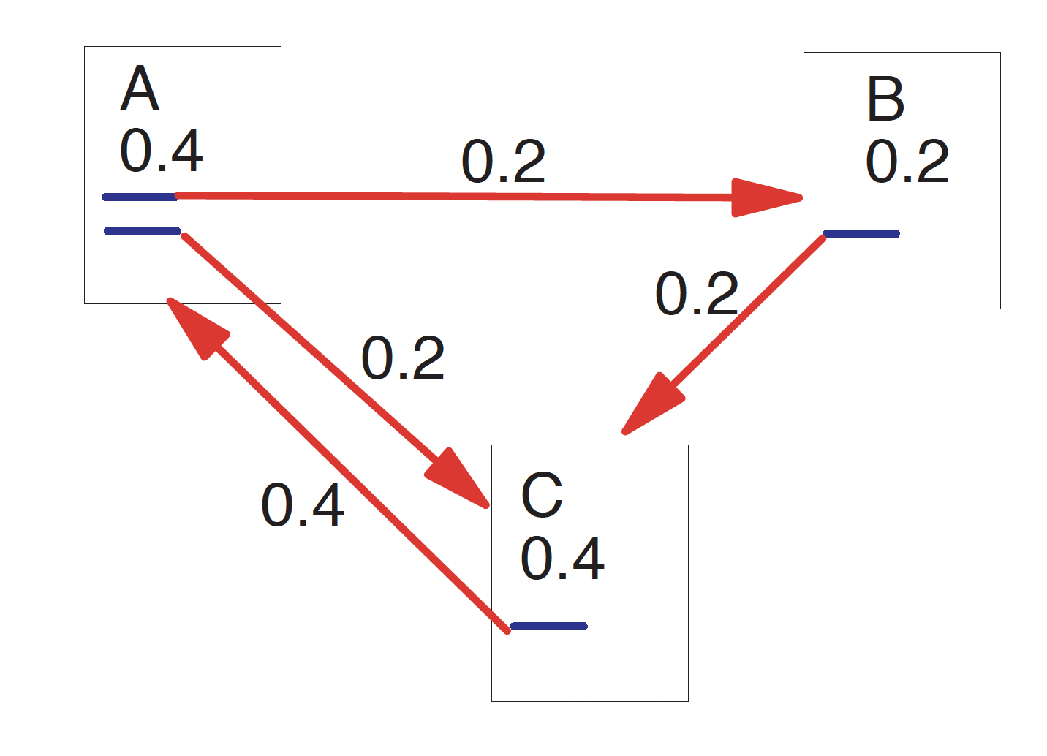
An example

Slide 26
PageRank: Stated Another Way
Let A be a square matrix with the rows and column corresponding to webpages.
Let A_{u,v} = 1/N_{u} if there is an edge from u to v and A_{u,v} = 0 if not.
If we treat R as a vector over web pages, then we have R = cAR.
So R is an eigenvector of A with eigenvalue c. In fact, we want the dominant eigenvector of A. It may be computed by repeatedly applying A to any nondegenerate start vector.

Slide 27
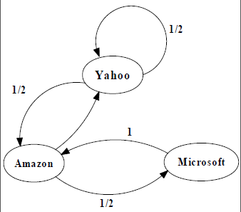
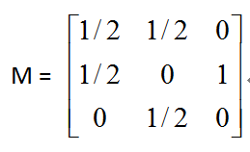
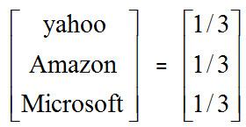
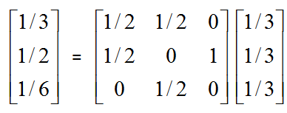
An example of Simplified PageRank
1/2
PageRank Calculation: first iteration

Slide 28
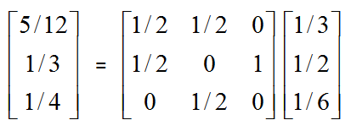
An example of Simplified PageRank
1/2
PageRank Calculation: second iteration

Slide 29
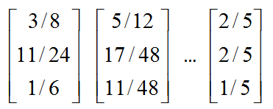
An example of Simplified PageRank
1/2
Convergence (2/5,2/5, 1/5) after some iterations

Slide 30
A Small Problem: Rank Sink
Consider two web pages that point to each other but to no other page. Suppose there is some web page which points to one of them.
During iteration, this loop will accumulate rank but never distribute any rank (since there are no outedges). The loop forms a sort of trap: rank sink

Slide 31
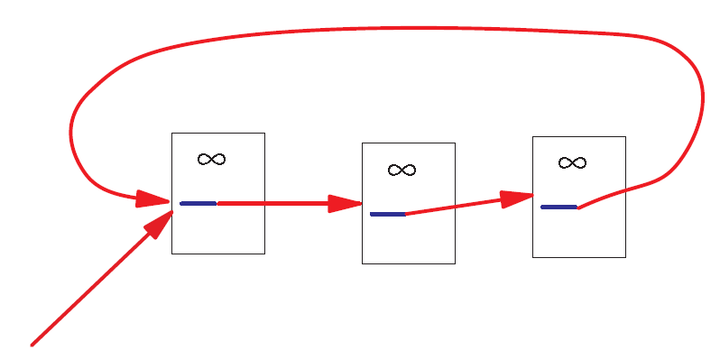
A Problem with Simplified PageRank
A loop:
During each iteration, the loop accumulates rank but never distributes rank to other pages!

Slide 32
Random Walks in Graphs
The Random Surfer Model
The simplified model: the standing probability distribution of a random walk on the graph of the web. simply keeps clicking successive links at random
The Modified Model
The modified model: the “random surfer” simply keeps clicking successive links at random, but periodically “gets bored” and jumps to a random page based on the distribution of E

Slide 33
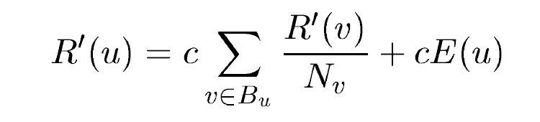
Modified Version of PageRank
where E(u) is some vector over the web pages that corresponds to a source of rank
E(u): a distribution of ranks of web pages that “users” jump to
when they “gets bored” after successive links at random.
In Matrix notation we have:
R’ = c(AR’ + E).

Slide 34
PageRank:
R’ = c(AR’ + E).
PR of all web pages can form a vector
A is a matrix.
Each row and column represents a page.
X_{u,v} = 1/C(u) if there is a link from u to v.
0 otherwise.
R’ = c (A+EI)R’ since ||R’||₁=1, I is the identity matrix
R’ is the eigenvector of (A+EI).

Slide 35
PageRank
When the number of pages is small, R’ can be computed efficiently.
However, when the number of page is large, computing R’ is a time consuming technique.
An iterative method is used for computation.
Any initial value of R’ is ok.
After applying the equation 50 times, R’ can be converged to a stable state.

Slide 36
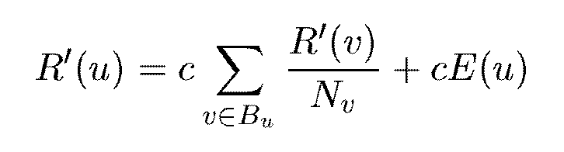


More general:

Slide 37
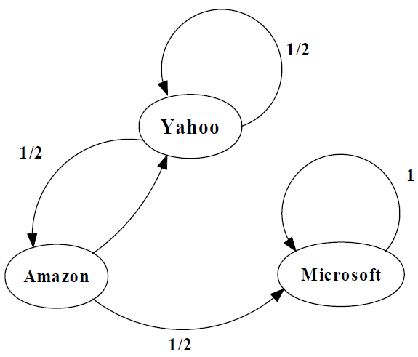
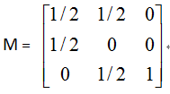

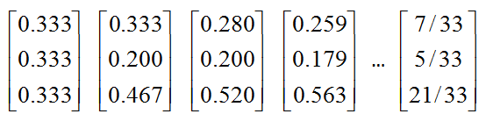
An example of Modified PageRank

Slide 38
Further understanding:
Typically, C₁+C₂=1, then we can rewrite for easy understanding for a specific web page A, its page rank PR(A) can be calculated as (C1=d, C2=1-d, E(u)=1):
PR(A) = (1-d) + d (PR(T₁) / C(T₁) + ….. + PR(T_{n}) / C(T_{n}) )
d: damping factor

Slide 39
Understanding the PageRank Algorithm from individual web pages
PR(A) = (1-d) + d (PR(T₁) / C(T₁) + ….. + PR(T_{n}) / C(T_{n}) )
PR(A) is the PageRank of page A
PR(T_{i}) is the PageRank of pages Ti which link to page A
C(T_{i}) is the number of outbound links on page T_{i}
d is a damping factor which can be set between 0 and 1
(usually set to 0.85)
A page’s PageRank = 0.15 + 0.85 * (a “share” of the PageRank of
every page that links to it)
“share” = the linking page’s PageRank divided by the number of
outbound links on the page
Notes:
39

Slide 40
Page A
Page B
PR = 1
PR = 1
PR(A) = 0.15 + 0.85 * PR(B)
PR(B) = 0.15 + 0.85 * PR(A)
We can't work out A's PageRank until we know B's PageRank, and we can't work
out B's PageRank until we know A's PageRank.
Iterations are necessary to calculate the most accurate values by
using inaccurate values
Typically, more iterations (~50) are necessary to get a good
approximation of the PageRank values of the whole web.
Notes:
40

Slide 41
Work on this example using modified version of PageRank, d=0.85
A
B
C
PR(A) = (1-d) + d (PR(T₁) / C(T₁) + ….. + PR(T_{n}) / C(T_{n}) )

Slide 42
PageRank of a Site
PageRank of a site is equal to the pagerank of all pages on that site.
The maximal PageRank of a site is equal to the total number of pages on the site.

Slide 43
Internal Linking
A website has a maximum amount of PageRank that is distributed
between its pages by internal links
The maximum amount of PageRank in a site increases as the
number of pages in the site increases
By linking poorly, it is possible to fail to reach the site’s maximum
PageRank, but it is not possible to exceed it.
Notes:
43

Slide 44
Internal Linking
Page A
Page B
Page C
PR = 1
PR = 1
PR = 1
Maximum PageRank is the amount of PageRank in the site.
So this site’s maximum PageRank is 3.
PR(A) = 0.15 + 0.85 * ( 0 ) = 0.15
PR(B) = 0.15 + 0.85 * ( 0 ) = 0.15
PR(C) = 0.15 + 0.85 * ( 0 ) = 0.15
Total PageRank in this site = 0.45
Wasting most of its potential PageRank!
Notes:
44

Slide 45
Internal Linking
Page A
Page B
Page C
PR = 1
PR = 1
PR = 1
PR(A) = 0.15 + 0.85 * ( 0 ) = 0.15
PR(B) = 0.15 + 0.85 * ( PR(A)/1 ) = 0.15 + 0.85 * ( 1 ) = 1
PR(C) = 0.15 + 0.85 * ( 0 ) = 0.15
After 100 iterations….
Notes:
45

Slide 46
Internal Linking
Page A
Page B
Page C
PR = 1
PR = 1
PR = 1
PR(A) = 0.15
PR(B) = 0.2775
PR(C) = 0.15
Total PageRank in this site = 0.5775
Slightly better but still not the best it could be
Notes:
46

Slide 47
Internal Linking
Page A
Page B
PR(A) = 0.15 + 0.85 * ( PR(B)/1 + PR(C) / 1)
= 0.15 + 0.85 * (1 + 1 )
= 0.15 + 1.7
= 1.85
PR = 1
PR = 1
PR(B) = 0.15 + 0.85 * ( PR(A)/2 )
= 0.15 + 0.85 * (0.5 )
= 0.15 + 0.425
= 0.575
Page C
PR(C) = 0.15 + 0.85 * ( PR(A)/2 )
= 0.15 + 0.85 * (0.5 )
= 0.15 + 0.425
= 0.575
PR = 1
Page A = 1.459459 Page B = 0.7702703 Page C = 0.7702703
After 100 iterations…
Notes:
47

Slide 48
Internal Linking
Page A
Page B
PR = 1
PR = 1
PR(A) = 0.15 + 0.85 * ( PR(B)/2 + PR(C) / 2)
= 0.15 + 0.85 * (0.5 + 0.5 )
= 0.15 + 0.85
= 1
Page C
PR(B) = 1
PR = 1
PR(C) = 1
Total PageRank in this site = 3
Good Linking!
Notes:
48

Slide 49
Internal Linking
Page A
Page B
PR(A) = 0.15 + 0.85 * ( PR(B)/1 + PR(C) / 2)
= 0.15 + 0.85 * (1 + 0.5 )
= 0.15 + 1.275
= 1.425
PR = 1
PR = 1
PR(B) = 0.15 + 0.85 * ( PR(A)/2 + PR(C)/2 )
= 0.15 + 0.85 * (0.5 + 0.5)
= 0.15 + 0.85
= 1
Page C
PR(C) = 0.15 + 0.85 * ( PR(A)/2 )
= 0.15 + 0.85 * (0.5 )
= 0.15 + 0.425
= 0.575
PR = 1
After 100 iterations…
Page A = 1.298245 Page B = 0.9999999 Page C = 0.7017543
Notes:
49

Slide 50
Internal Linking
Page A
Page B
PR = 1
PR = 1
PR(A) = 1.298
Page C
PR(B) = 1.000
PR(C) = 0.702
PR = 1
Total PageRank in this site = 3
Page A and Page C lose some PageRank
Page B gains some PageRank
Notes:
50

Slide 51
Site 1
Site 2
Another example: two sites
Page A
Page C
PR(A) = 0.15 + 0.85 * PR(B) = 1
PR(B) = 0.15 + 0.85 * PR(A) = 1
PR = 1
PR = 1
PR(C) = 0.15 + 0.85 * PR(D) = 1
PR(D) = 0.15 + 0.85 * PR(C) = 1
Page B
Page D
PR = 1
PR = 1
Notes:
51

Slide 52
Site 1
Site 2
Add one outbound link from Page A to C
Page A
Page C
PR(A) = 0.15 + 0.85 * PR(B) = 1
PR(B) = 0.15 + 0.85 * PR(A) = 1
PR = 1
PR = 1
PR(C) = 0.15 + 0.85 * PR(D) = 1
PR(D) = 0.15 + 0.85 * PR(C) = 1
Page B
Page D
PR(A) = 0.15 + 0.85 * PR(B) = 0.43
PR(B) = 0.15 + 0.85 * PR(A)/2 = 0.33
PR = 1
PR = 1
PR(C) = 0.15 + 0.85 * (PR(A)/2 + PR(D) = 1.67
PR(D) = 0.15 + 0.85 * PR(C) = 1.57
Site 1 loses: 0.76 - 2= -1.24,
Site 2 gains: 3.24 – 2 = 1.24
The PageRank benefit for one site equals the PageRank loss of the other
Notes:
52

Slide 53
One more problem: Dangling Links
Links that point to any page with no outgoing links
Most are pages that have not been downloaded yet
Affect the model since it is not clear where their weight should be distributed
Do not affect the ranking of any other page directly
Can be simply removed before pagerank calculation and added back afterwards

Slide 54
Example of Dangling Links
Page A
Page C
Danglink links are links that point to any
Page with no outgoing links.
After n rounds, they will converge at:
PR = 1
PR = 1
PR(A) = 0.15 + 0.85 * PR(B) = 0.43
Page B
PR(B) = 0.15 + 0.85 * PR(A) /2= 0.33
PR(C) = 0.15 + 0.85 * PR(A)/2 = 0.33
The total PageRank is only 1.10 which is only
one third of the maximum PageRank.
PR = 1
To prevent PageRank from the negative effects of dangling links, pages without
outbound links have to be removed from the database until the PageRank values are
computed.
Notes:
54

Slide 55
Example of Dangling Links
Page A
Page C
PR(A) = 0.15 + 0.85 * PR(B) = 0.43
PR(B) = 0.15 + 0.85 * PR(A) = 0.33
PR = 1
PR = 1
PR(C) = 0.15 + 0.85 * PR(A) = 0.33
Page B
PR(A) = 0.15 + 0.85 * PR(B) = 1
PR(B) = 0.15 + 0.85 * PR(A) = 1
PR = 1
Notes:
55

Slide 56
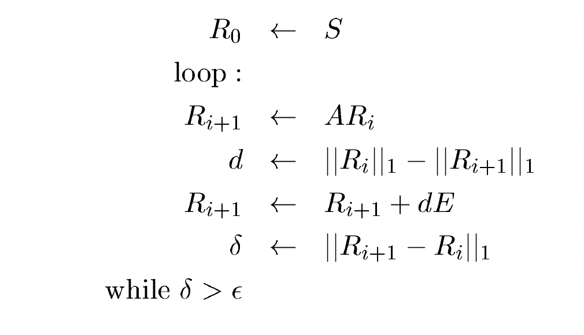
PageRank Algorithm
Let S be almost any vector over Web pages (for example E). Then PageRank may be computed as follows:

Slide 57
PageRank
A
C
B
Initially: PR(A)=1, PR(B)=1, PR(C)=1, calculate when to converge at what PR values of A, B, C?

Slide 58
PageRank Implementation
Convert each URL into a unique integer and store each hyperlink in a database using the integer IDs to identify pages
Sort the link structure by ID
Remove all the dangling links from the database
Make an initial assignment of ranks and start iteration
Choosing a good initial assignment can speed up the pagerank
Adding the dangling links back.

Slide 59
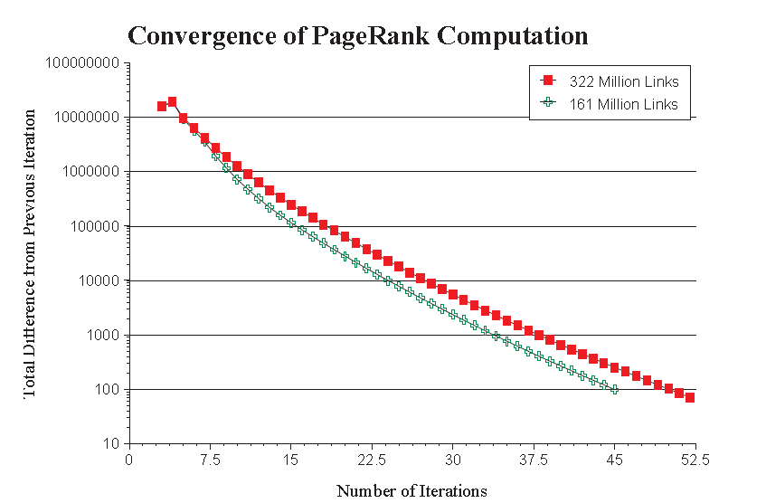
Convergence Property
PR (322 Million Links): 52 iterations
PR (161 Million Links): 45 iterations
Scaling factor is roughly linear in logn

Slide 60
Application of PageRank: Search Engines
Two search engines:
Title-based search engine
Full text search engine
Title-based search engine
Searches only the “Titles”
Finds all the web pages whose titles contain all the query words
Sorts the results by PageRank
Very simple and cheap to implement
Title match ensures high precision, and PageRank ensures high quality
Full text search engine
Called Google
Examines all the words in every stored document and also performs PageRank (Rank Merging)
More precise but more complicated

Slide 61
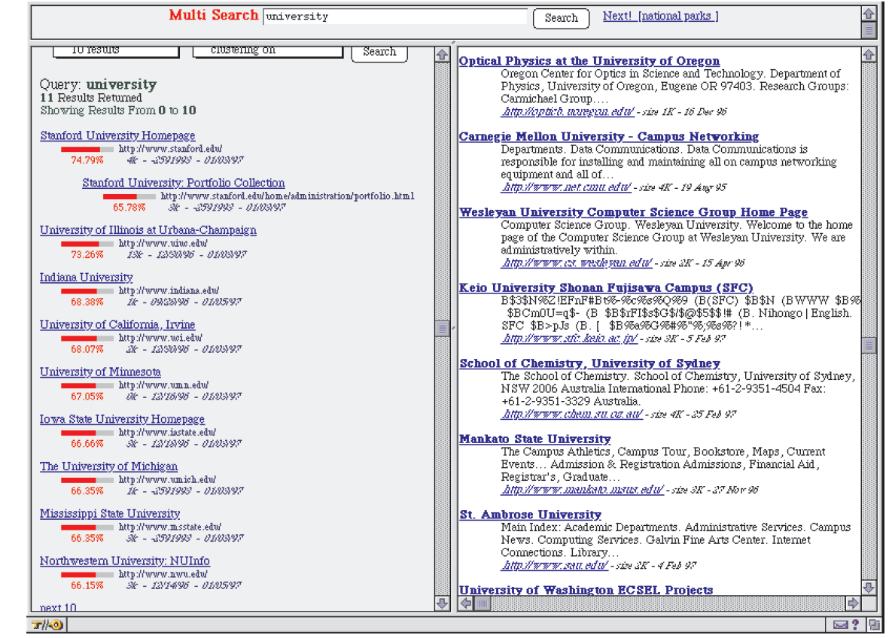
Searching with PageRank (vs. Altavista)

Slide 62
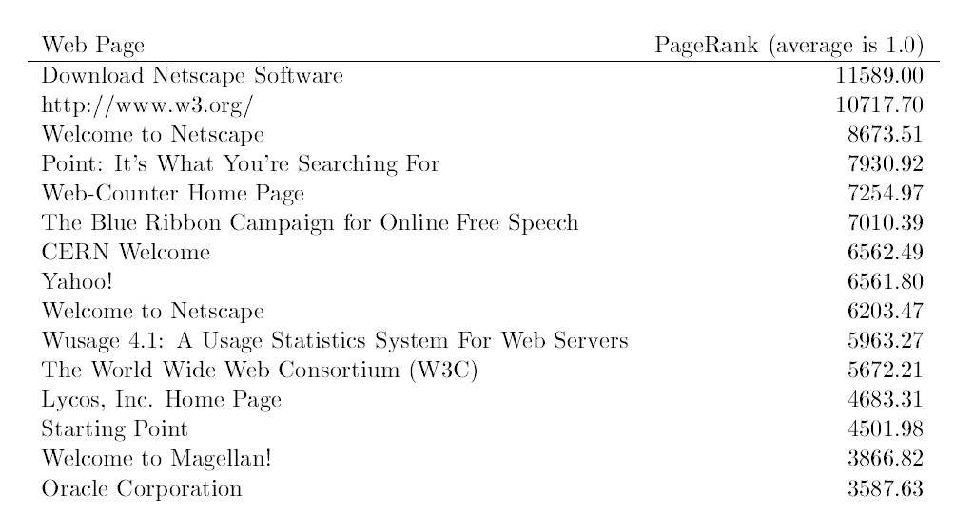

Searching with PageRank

Slide 63
PageRank vs. Web Traffic
Some highly accessed web pages have low page rank possibly because
People do not want to link to these pages from their own web pages (such as pornographic sites…)
Some important backlinks are omitted
Use usage data as a start vector for PageRank.

Slide 64
Conclusion
PageRank is a global ranking of all web pages based on their locations in the web graph structure
PageRank uses information which is external to the web pages – backlinks
Backlinks from important pages are more significant than backlinks from average pages
The structure of the web graph is very useful for information retrieval tasks.

Slide 65
References
Page, Lawrence and Brin, Sergey and Motwani, Rajeev and Winograd, Terry (1999) The PageRank Citation Ranking: Bringing Order to the Web, http://ilpubs.stanford.edu:8090/422/
https://web.eecs.umich.edu/~michjc/eecs584/notes/lecture19-pagerank.ppt
https://www.cs.duke.edu/courses/cps049s/spring08/Slides/bryan.ppt
https://www.cse.buffalo.edu/faculty/azhang/cse601/Pagerank.ppt

